Slide 1
Introduction to functional data analysis
MQT 8003 – Statistical learning methods and applications
Session 11
FDA Chapters 1 (Sect 1.1-1.5), 3 (Sect 3.1-3.3), 5 (Sect 5.1-5.3)
2 April 2020

Slide 2
Summary of previous session
Moving beyond linearity
Overview
Basis function approach
Splines
Regression splines
Smoothing splines (roughness penalties)

Slide 3
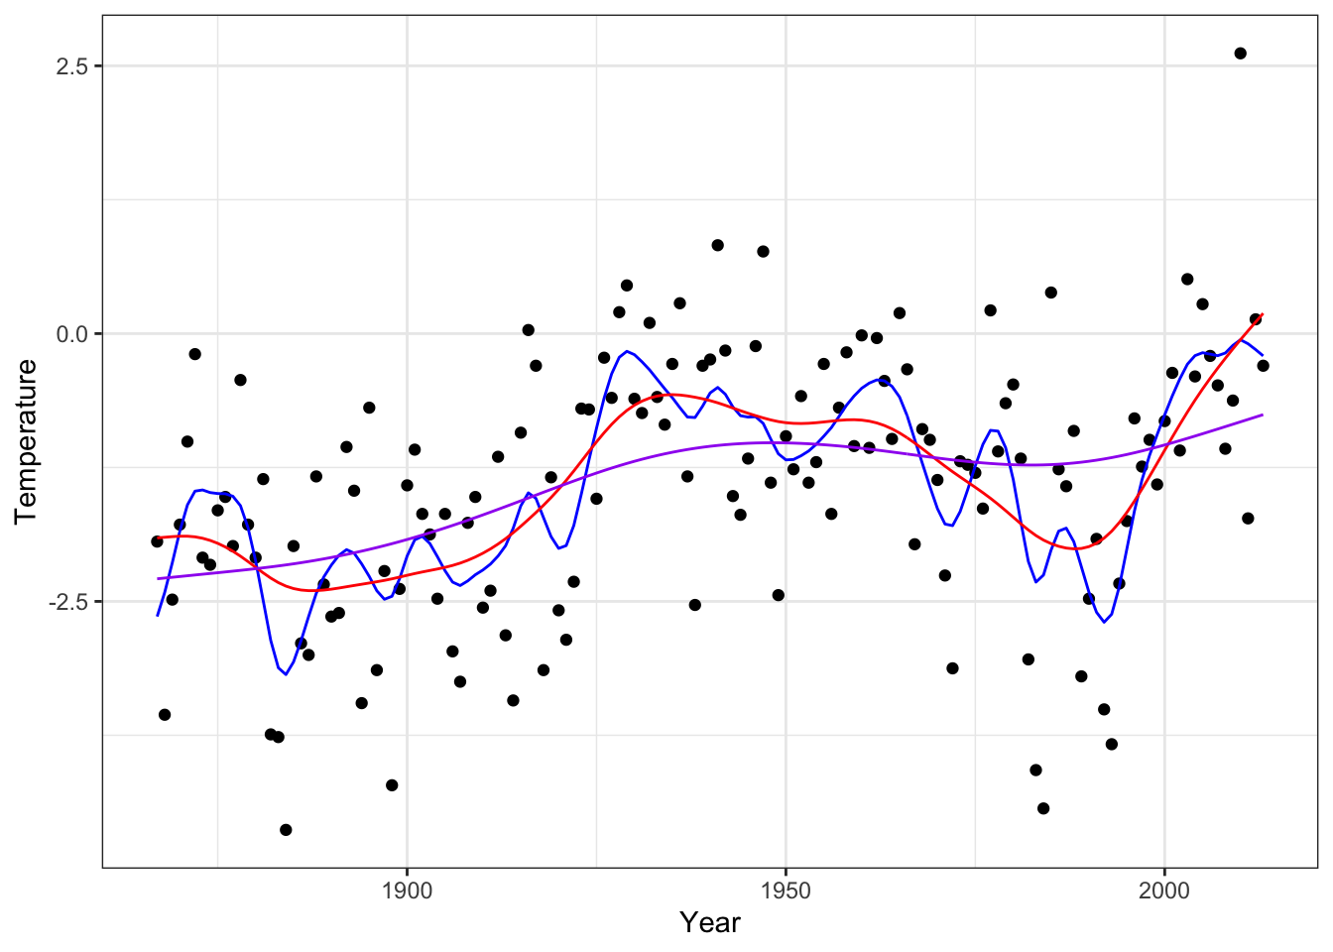
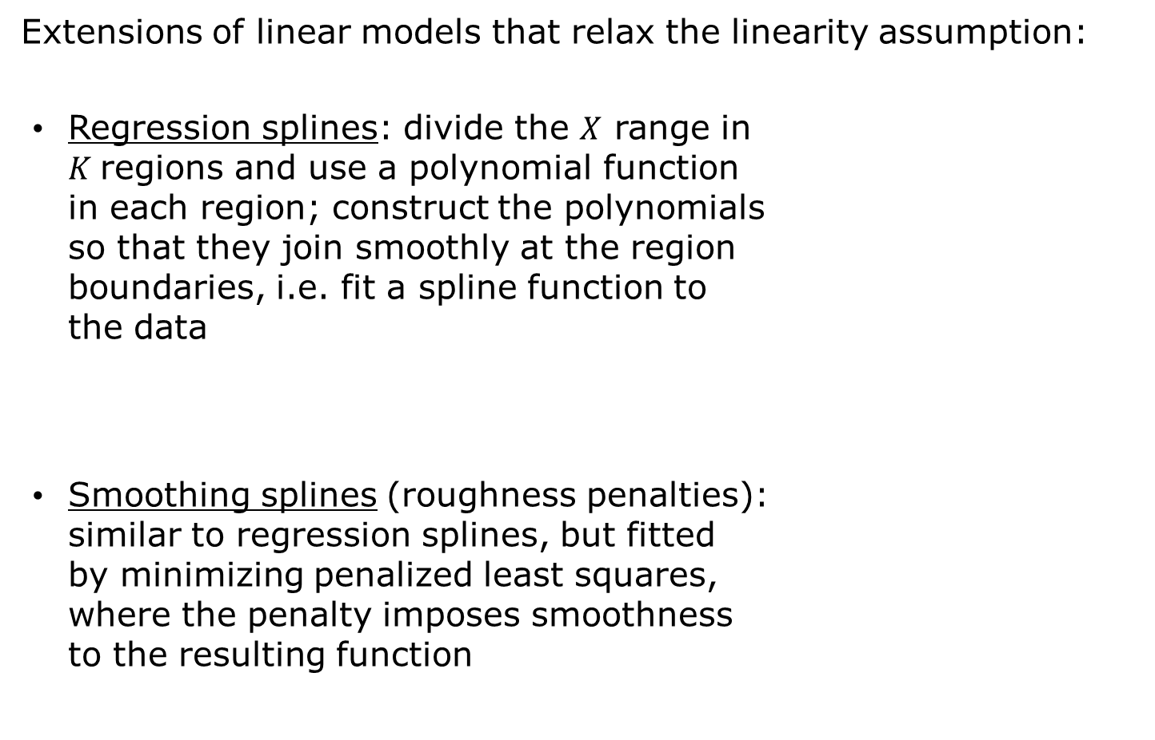
Moving beyond linearity
Extensions of linear models that relax the linearity assumption:
Regression splines: divide the $X$ range in
$K$regions and use a polynomial function
in each region; construct the polynomials
so that they join smoothly at the region
boundaries, i.e. fit a spline function to
the data
Smoothing splines (roughness penalties):
similar to regression splines, but fitted
by minimizing penalized least squares,
where the penalty imposes smoothness
to the resulting function
Moving beyond linearity

Slide 4
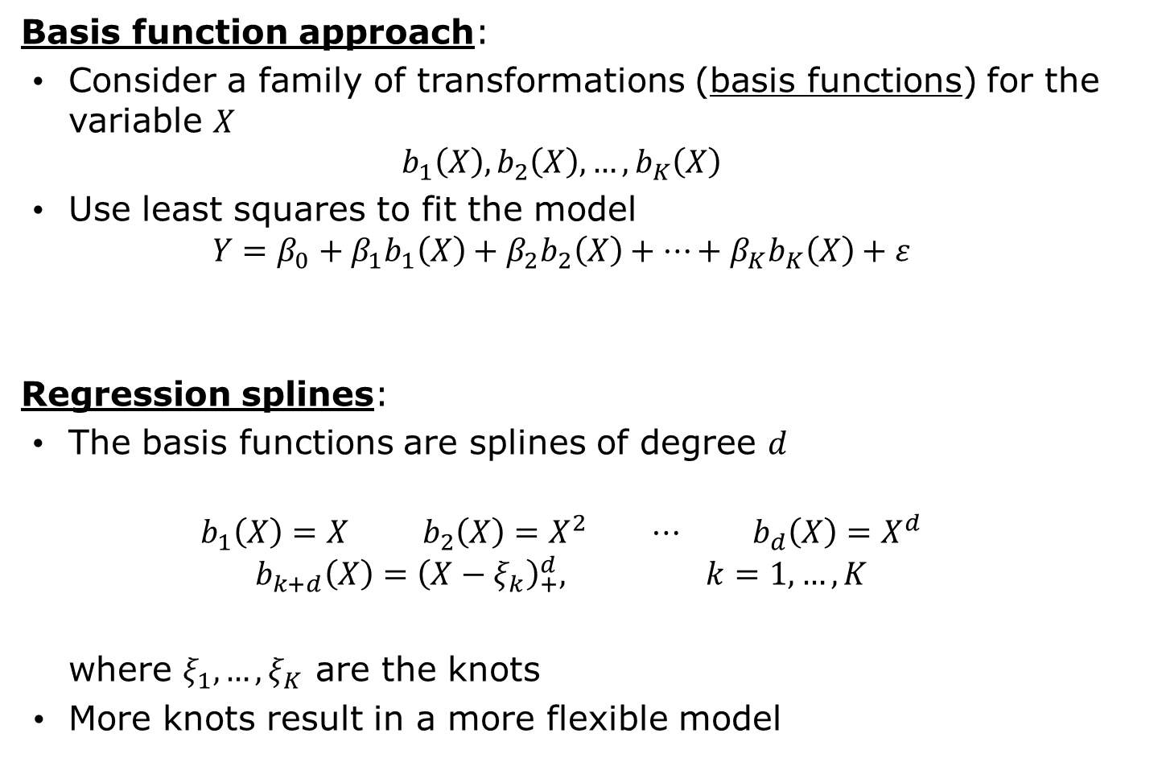
Basis function approach and regression splines
Basis function approach:
Consider a family of transformations (basis functions) for the variable $X$
$$b_{1}\left(X\right),b_{2}\left(X\right),…,b_{K}\left(X\right)$$
Use least squares to fit the model
$$Y=β_{0}+β_{1}b_{1}\left(X\right)+β_{2}b_{2}\left(X\right)+…+β_{K}b_{K}\left(X\right)+ε$$
Regression splines:
The basis functions are splines of degree $d$
$$b_{1}\left(X\right)=X b_{2}\left(X\right)=X^{2} ⋯ b_{d}\left(X\right)=X^{d}$$
$$b_{k+d}\left(X\right)={\left(X−ξ_{k}\right)}_{+}^{d}, k=1,…,K$$
where $ξ_{1},…,ξ_{K}$ are the knots
More knots result in a more flexible model
Moving beyond linearity

Slide 5
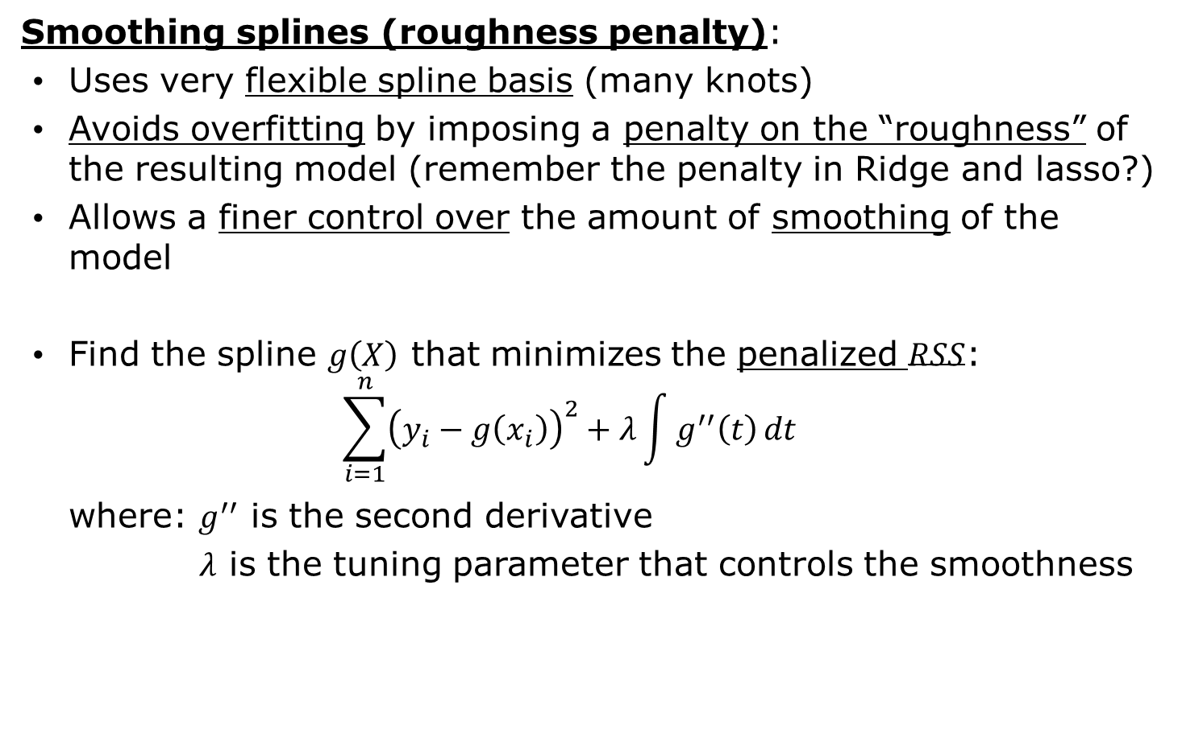
Smoothing splines (roughness penalty)
Smoothing splines (roughness penalty):
Uses very flexible spline basis (many knots)
Avoids overfitting by imposing a penalty on the “roughness” of the resulting model (remember the penalty in Ridge and lasso?)
Allows a finer control over the amount of smoothing of the model
Find the spline $g\left(X\right)$ that minimizes the penalized $RSS$:
$$\sum_{i=1}^{n}{{\left(y_{i}−g\left(x_{i}\right)\right)}^{2}}+λ\int{g^{′′}\left(t\right)}dt$$
where: $g^{′′}$ is the second derivative
$λ$ is the tuning parameter that controls the smoothness
Splines

Slide 6
Topics
What is functional data analysis?
Overview and examples
First steps in functional data analysis
Computing curves from raw data
Basis functions
Computing curves using smoothing

Slide 7
What is functional data analysis FDA Chapter 1 (Sections 1.1-1.5)

Slide 8
What is functional data analysis?
Example: Handwritten data
Data: X-Y coordinates for 20 replications of writing “fda” (by Jim Ramsay, one of the authors of the book we are using…). 1401 coordinates for each replication
20 observations (repetitions)
For each repetition we have:
X-Y coordinates as function of time
(two numerical variables)
1401 time points
What is functional data analysis?

Slide 9
What is functional data analysis?
Example: Handwritten data
Let’s visualize the two coordinates separately, as function of time
For each coordinate, we have:
Complex trend/pattern (not easily described with a formula)
Smooth trend/pattern
Large number of measurements for each curve (1401 time points)
Functional data analysis:
Each curve (repetition) is a single observation, a single data (20 observations)
What is functional data analysis?

Slide 10
What is functional data analysis?
Example: Handwritten data
Let’s look at the Y coordinate more closely. What are the most obvious features of the curves?
Measured at very high resolutions (a lot of very close time points)
The 20 observations have similar trend
Generally, the curves go up, then down and then again up
What is functional data analysis?

Slide 11
What is functional data analysis?
Example: Handwritten data
The most important characteristic of these curves is their smoothness
These data describe (nearly) a process that changes smoothly and continuously over time
Functional data analysis:
Analysis of data that can be represented as curves, as mathematical functions
What is functional data analysis?

Slide 12
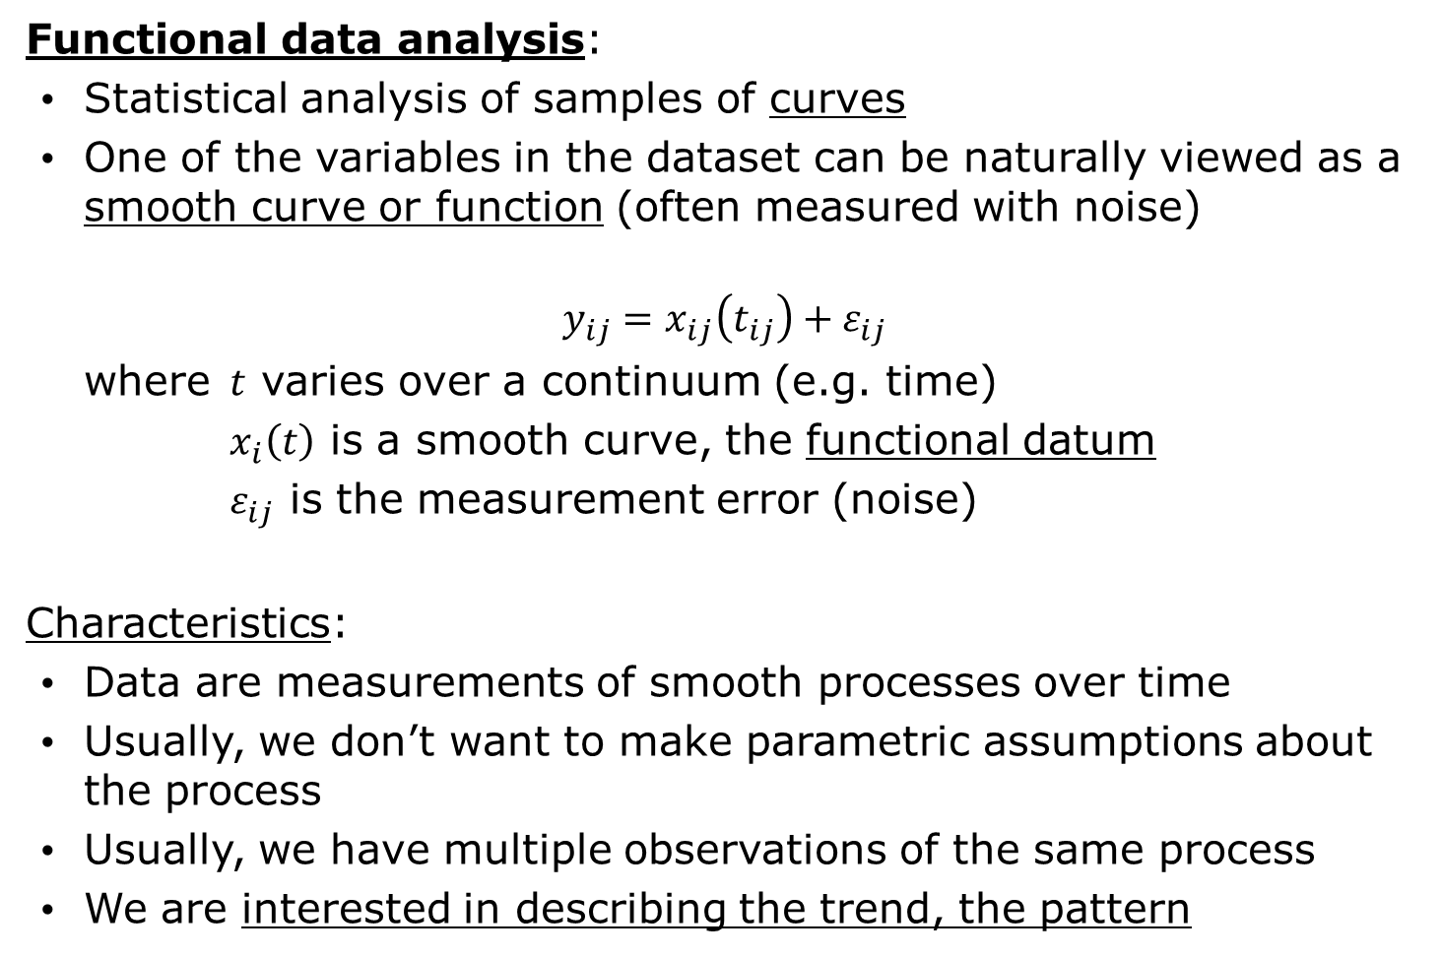
What is functional data analysis?
Functional data analysis:
Statistical analysis of samples of curves
One of the variables in the dataset can be naturally viewed as a smooth curve or function (often measured with noise)
$$y_{ij}=x_{ij}\left(t_{ij}\right)+ε_{ij}$$
where $t$ varies over a continuum (e.g. time)
$x_{i}\left(t\right)$ is a smooth curve, the functional datum
$ε_{ij}$ is the measurement error (noise)
Characteristics:
Data are measurements of smooth processes over time
Usually, we don’t want to make parametric assumptions about the process
Usually, we have multiple observations of the same process
We are interested in describing the trend, the pattern
What is functional data analysis?

Slide 13
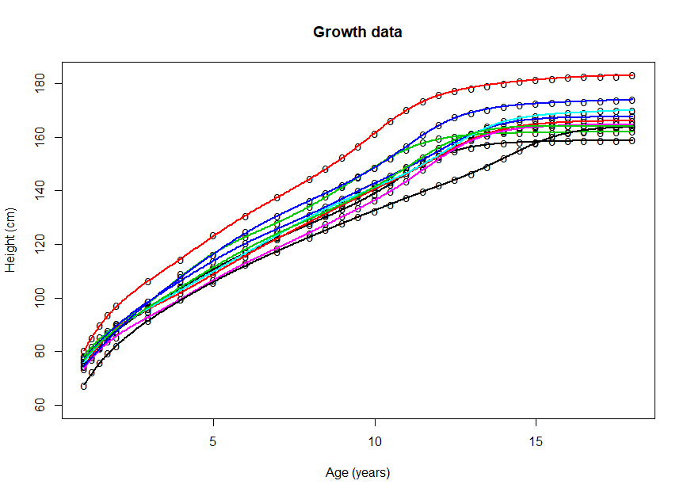
What is functional data analysis?
In practice, we can have curves:
With a lot of noise
Measured at low resolution (or even sparsely)
Measured at non equally-spaced points
Measured at different time points
Examples:
Low resolution
Non equally-spaced points
Lot of noise
What is functional data analysis?

Slide 14
What is functional data analysis?
In practice, we can have curves:
With a lot of noise
Measured at low resolution (or even sparsely)
Measured at non equally-spaced points
Measured at different time points
Examples:
Sparse data (average of 6.4 measurements per observations)
Non equally-spaced points
Different time points for each observation
What is functional data analysis?

Slide 15
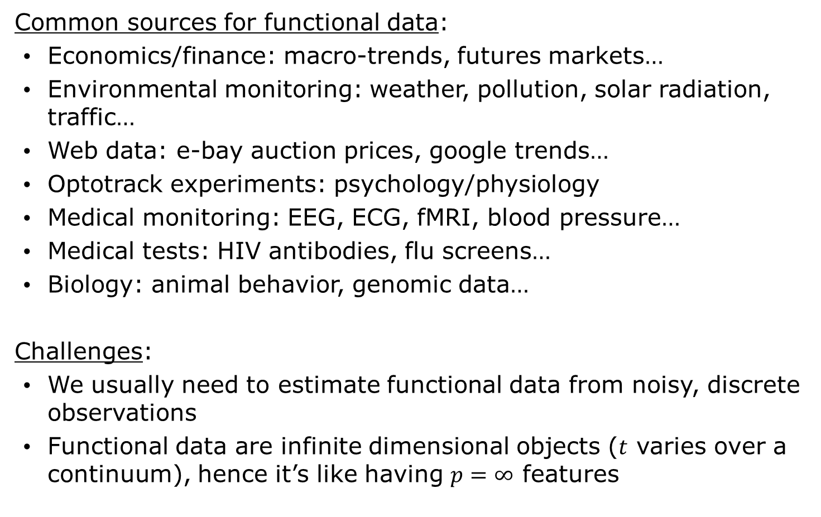
What is functional data analysis?
Common sources for functional data:
Economics/finance: macro-trends, futures markets…
Environmental monitoring: weather, pollution, solar radiation, traffic…
Web data: e-bay auction prices, google trends…
Optotrack experiments: psychology/physiology
Medical monitoring: EEG, ECG, fMRI, blood pressure…
Medical tests: HIV antibodies, flu screens…
Biology: animal behavior, genomic data…
Challenges:
We usually need to estimate functional data from noisy, discrete observations
Functional data are infinite dimensional objects ($t$ varies over a continuum), hence it’s like having $p=∞$ features
What is functional data analysis?

Slide 16
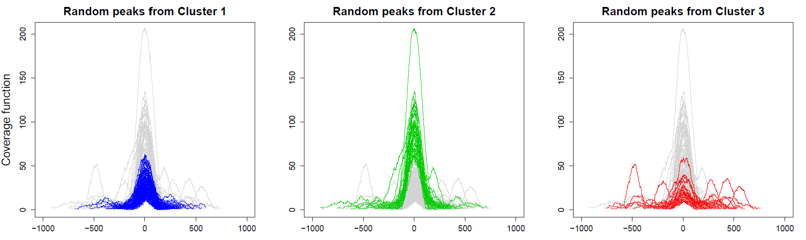
What is functional data analysis?
Essential questions on functional data:
How do we go from discrete measurements to continuous functional data? Smoothing (see this session)
How do we describe random variation in functional data? Functional principal component analysis (see book)
How do we decide if groups of functional data are different? Functional hypothesis testing
How do we study the relationship between functional data and other scalar variables? And the relationship between functional data and other functional data? Functional linear models (see session 12)
How do we find groups of functional
data? Functional clustering
What is functional data analysis?

Slide 17
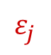






First steps in functional data analysis
In reality, we don’t observe a functional datum $x\left(t\right)$ directly.
What we have is a finite set of $n$ measurements $y_{1},…,y_{n}$ corresponding to noisy evaluations of $x\left(t\right)$on discrete grid $t_{1},…,t_{n}$
$$y_{j}=x\left(t_{j}\right)+ε_{j}$$
$$x_{j}\left(t_{j}\right)$$
$$y_{j}$$
$$ε_{j}$$
$x\left(t\right)$
$$t_{j}$$
$t$
What is functional data analysis?

Slide 18
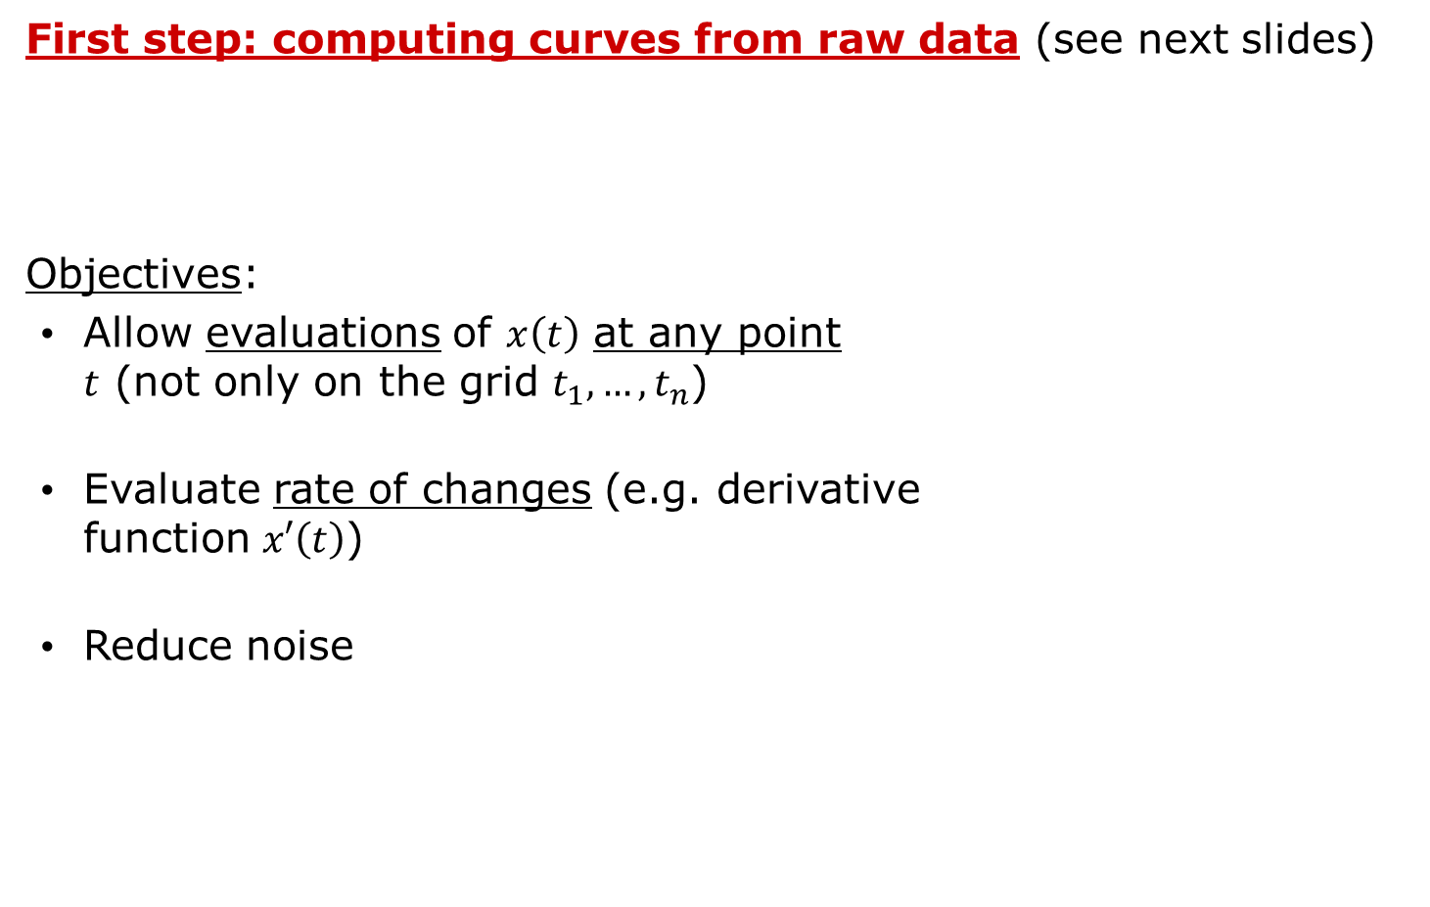
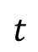
First steps in functional data analysis
First step: computing curves from raw data (see next slides)
Objectives:
Allow evaluations of $x\left(t\right)$ at any point
$t$ (not only on the grid $t_{1},…,t_{n}$)
Evaluate rate of changes (e.g. derivative
function $x′\left(t\right)$)
Reduce noise
$t$
What is functional data analysis?

Slide 19

First steps in functional data analysis
Suppose we have a functional dataset with $N$ observations
$$x_{1}\left(t\right),…,x_{N}\left(t\right)$$
A common problem is that the recording starts at different times for the different observations
The resulting curves are then misaligned on the $t$ axis… a lot of the variability observed in the dataset is due to this misalignment, while all curves show very similar patterns!
What is functional data analysis?

Slide 20
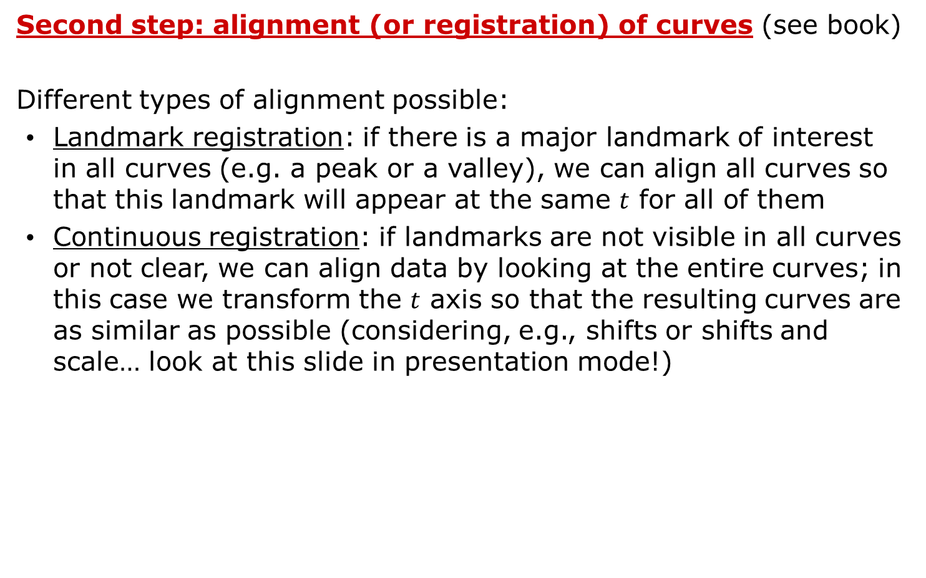
First steps in functional data analysis
Second step: alignment (or registration) of curves (see book)
Different types of alignment possible:
Landmark registration: if there is a major landmark of interest in all curves (e.g. a peak or a valley), we can align all curves so that this landmark will appear at the same $t$ for all of them
Continuous registration: if landmarks are not visible in all curves or not clear, we can align data by looking at the entire curves; in this case we transform the $t$ axis so that the resulting curves are as similar as possible (considering, e.g., shifts or shifts and scale… look at this slide in presentation mode!)
Only shift
Shift and scale
What is functional data analysis?

Slide 21
What is functional data analysis?
Chapter 1
Read Sections 1.1-1.5
(pages 1-16)
https://link-springer-com.acces.bibl.ulaval.ca/book/10.1007%2F978-0-387-98185-7
Moving beyond linearity

Slide 22
Computing curves from raw data FDA Chapter 3 (Sections 3.1-3.3), Chapter 5 (Sections 5.1-5.3)

Slide 23

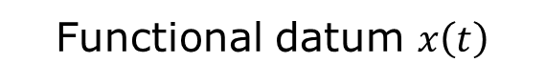
Computing curves from raw data
How do we compute curves from raw data?
Raw data $y_{1},…,y_{n}$
Functional datum $x\left(t\right)$
Computing curves from raw data

Slide 24
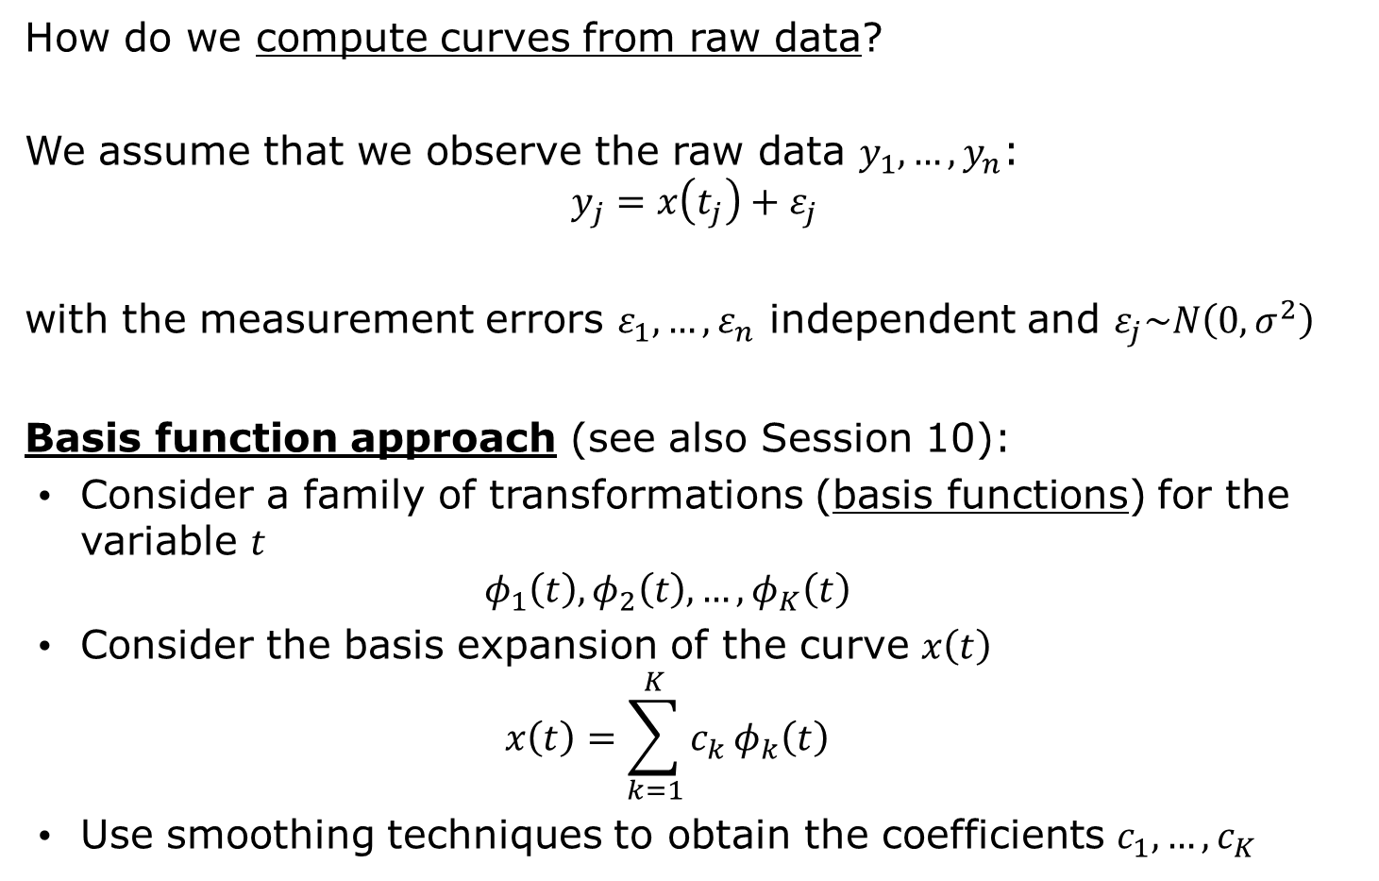
Basis functions
How do we compute curves from raw data?
We assume that we observe the raw data $y_{1},…,y_{n}$:
$$y_{j}=x\left(t_{j}\right)+ε_{j}$$
with the measurement errors $ε_{1},…,ε_{n}$ independent and $ε_{j}\sim N\left(0,σ^{2}\right)$
Basis function approach (see also Session 10):
Consider a family of transformations (basis functions) for the variable $t$
$$φ_{1}\left(t\right),φ_{2}\left(t\right),…,φ_{K}\left(t\right)$$
Consider the basis expansion of the curve $x\left(t\right)$
$$x\left(t\right)=\sum_{k=1}^{K}{c_{k}}φ_{k}\left(t\right)$$
Use smoothing techniques to obtain the coefficients $c_{1},…,c_{K}$
Computing curves from raw data

Slide 25
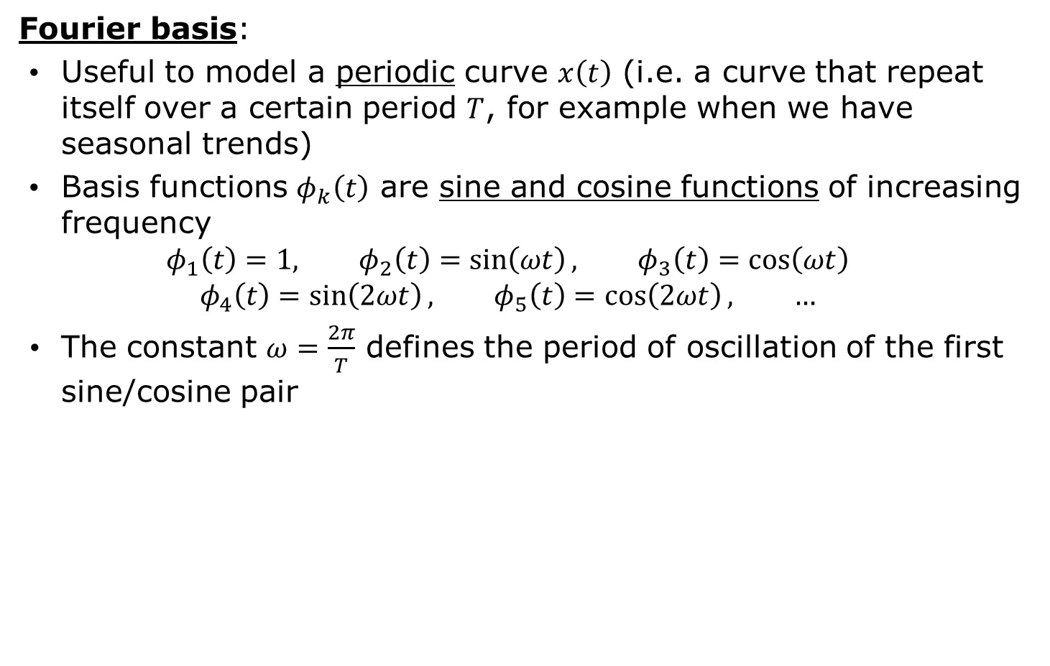
Basis functions
Fourier basis:
Useful to model a periodic curve $x\left(t\right)$ (i.e. a curve that repeat itself over a certain period $T$, for example when we have seasonal trends)
Basis functions $φ_{k}\left(t\right)$ are sine and cosine functions of increasing frequency
$$φ_{1}\left(t\right)=1, φ_{2}\left(t\right)=\sin\left(ωt\right), φ_{3}\left(t\right)=\cos\left(ωt\right)$$
$$φ_{4}\left(t\right)=\sin\left(2ωt\right), φ_{5}\left(t\right)=\cos\left(2ωt\right), …$$
The constant $ω=\frac{2π}{T}$ defines the period of oscillation of the first sine/cosine pair
Computing curves from raw data

Slide 26

Basis functions
Spline basis (see also Session 10):
Useful to model a non-periodic curve $x\left(t\right)$
Piecewise polynomials of degree $d$ (order $d+1$), with continuity in derivatives at the knots up to degree $d−1$
More knots and higher degree results in a more flexible model
Degree 0 (order 1): piecewise constant, discontinuous
Computing curves from raw data

Slide 27

Basis functions
Spline basis (see also Session 10):
Useful to model a non-periodic curve $x\left(t\right)$
Piecewise polynomials of degree $d$ (order $d+1$), with continuity in derivatives at the knots up to degree $d−1$
More knots and higher degree results in a more flexible model
Degree 1 (order 2): piecewise linear, continuous
Computing curves from raw data

Slide 28

Basis functions
Spline basis (see also Session 10):
Useful to model a non-periodic curve $x\left(t\right)$
Piecewise polynomials of degree $d$ (order $d+1$), with continuity in derivatives at the knots up to degree $d−1$
More knots and higher degree results in a more flexible model
Degree 2 (order 3): piecewise quadratic, continuous derivative
Computing curves from raw data

Slide 29
Basis systems
Chapter 3
Read Sections 3.1-3.3
(pages 29-39)
https://link-springer-com.acces.bibl.ulaval.ca/book/10.1007%2F978-0-387-98185-7
Computing curves from raw data

Slide 30
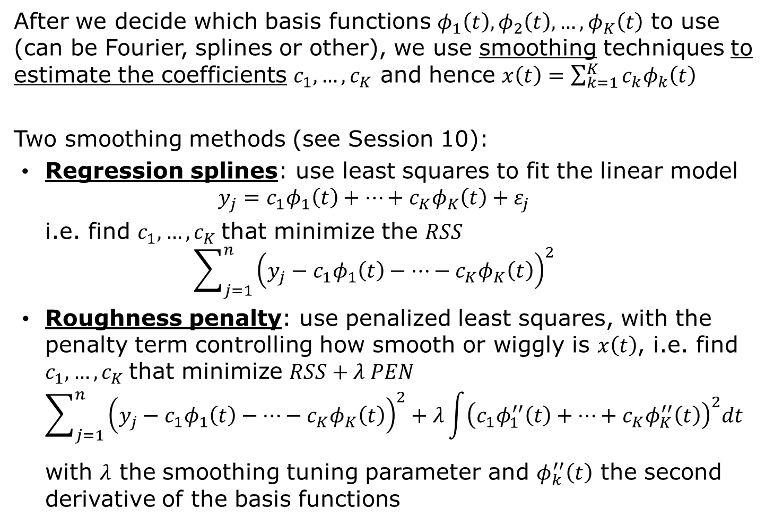
Computing curves using smoothing
After we decide which basis functions $φ_{1}\left(t\right),φ_{2}\left(t\right),…,φ_{K}\left(t\right)$ to use (can be Fourier, splines or other), we use smoothing techniques to estimate the coefficients $c_{1},…,c_{K}$ and hence $x\left(t\right)=\sum_{k=1}^{K}{c_{k}φ_{k}\left(t\right)}$
Two smoothing methods (see Session 10):
Regression splines: use least squares to fit the linear model
$$y_{j}=c_{1}φ_{1}\left(t\right)+⋯+c_{K}φ_{K}\left(t\right)+ε_{j}$$
i.e. find $c_{1},…,c_{K}$that minimize the $RSS$
$$\sum_{j=1}^{n}{{\left(y_{j}−c_{1}φ_{1}\left(t\right)−⋯−c_{K}φ_{K}\left(t\right)\right)}^{2}}$$
Roughness penalty: use penalized least squares, with the penalty term controlling how smooth or wiggly is $x\left(t\right)$, i.e. find $c_{1},…,c_{K}$that minimize $RSS+λ PEN$
$$\sum_{j=1}^{n}{{\left(y_{j}−c_{1}φ_{1}\left(t\right)−⋯−c_{K}φ_{K}\left(t\right)\right)}^{2}}+λ\int{{\left(c_{1}φ_{1}^{′′}\left(t\right)+⋯+c_{K}φ_{K}^{′′}\left(t\right)\right)}^{2}dt}$$
with $λ$ the smoothing tuning parameter and $φ_{k}^{′′}\left(t\right)$ the second derivative of the basis functions
Computing curves from raw data

Slide 31
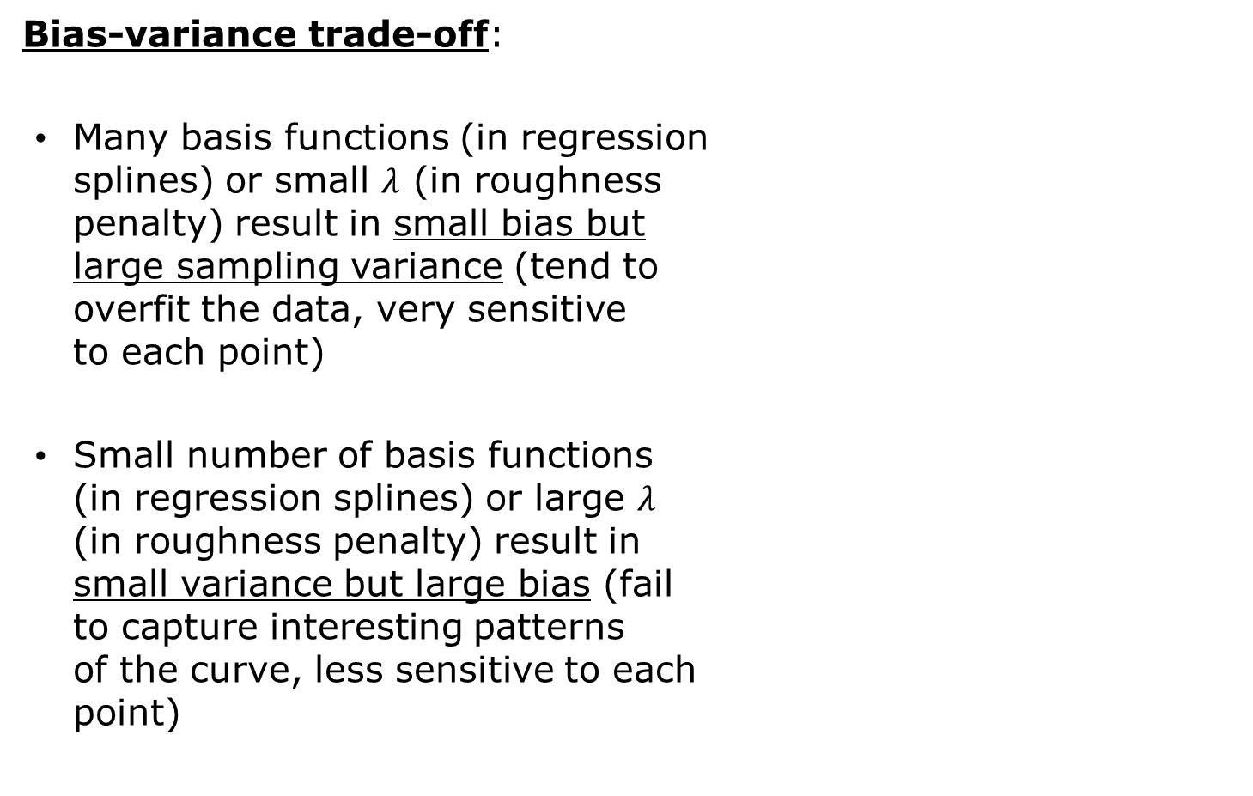
Computing curves using smoothing
Bias-variance trade-off:
Many basis functions (in regression
splines) or small $λ$ (in roughness
penalty) result in small bias but
large sampling variance (tend to
overfit the data, very sensitive
to each point)
Small number of basis functions
(in regression splines) or large $λ$
(in roughness penalty) result in
small variance but large bias (fail
to capture interesting patterns
of the curve, less sensitive to each
point)
Computing curves from raw data

Slide 32
Computing curves using smoothing
Example: Canadian weather
Goal: Study annual weather cycle in different Canadian locations
Data: Temperature.C (daily temperature, average 1960-1994), Precipitation.mm (daily rainfall, average 1960-1994), place (name of the location) for 35 weather stations in Canada
Questions:
What is the annual pattern of temperature in each of the 35 Canadian locations? Is it the same pattern for all of them?
How can we compute temperature curves for each location?
How do different smoothing methods compare?
Look at the files intro FDA.Rmd and/or intro FDA.nb.html
Note: we use the package fda (not the R smoothing functions of Session 11)
Computing curves from raw data

Slide 33
Basis systems
Chapter 5
Read Sections 5.1-5.3
(pages 59-69)
https://link-springer-com.acces.bibl.ulaval.ca/book/10.1007%2F978-0-387-98185-7
Computing curves from raw data

